Slide 1
Harmonics for Poets
Rockville Science Center
18 May 2023

Slide 2
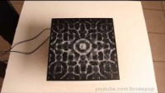
Prelude: The Chladni Plate
Named for Ernst Chladni, the “father of acoustics”
What is special about these frequencies?
Why does the salt form these patterns?
We will return to these questions.

Slide 3
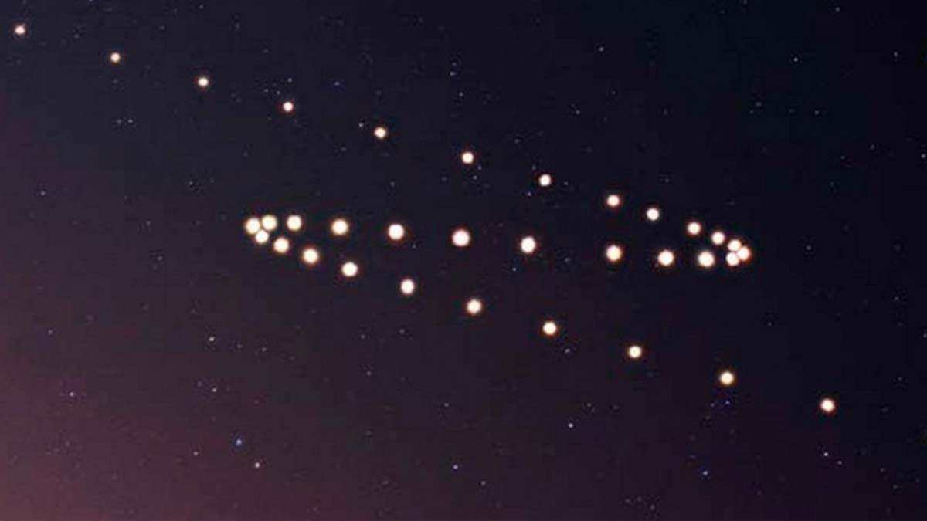
Planets in Retrograde
When observed from Earth, stars travel in a perfect arc.
However, planets travel along more complex curves.
Planets will often turn around, or “retrograde.”

Slide 4
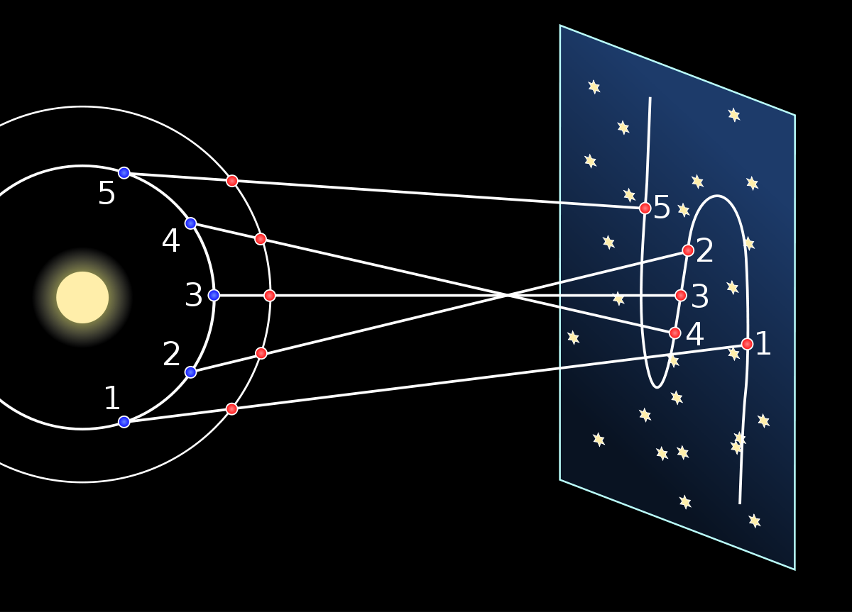
Planets in Retrograde
The name “Planet” comes from the Greek planetai, which means “wanderer.”
The apparent retrograde motion results from the fact that our observation position is also moving in an orbit.

Slide 5
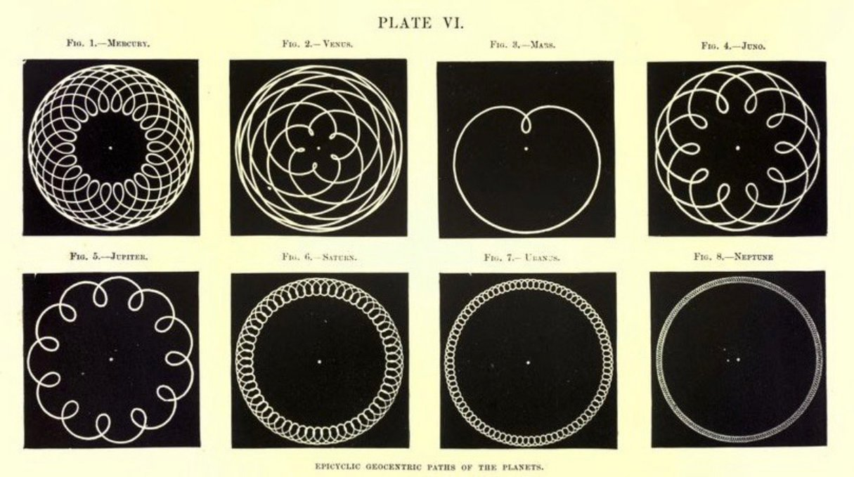
Planets in Retrograde
The retrograde and prograde motion makes beautiful curves called “epicycloids.”
Here we have the geocentric orbits of the seven other planets (and the asteroid Juno)

Slide 6
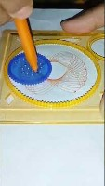
The Original Spirograph
The Marvelous Wondergraph was first offered in the Sears catalog in 1908.
The Spirograph as we know it was invented by Denys Fisher in 1965 and first exhibited at the Nuremberg International Toy Fair.
The center of the gear travels around a circle.
The pen is set away from the center of the gear, so that it rotates around a smaller circle as the gear rotates.

Slide 7
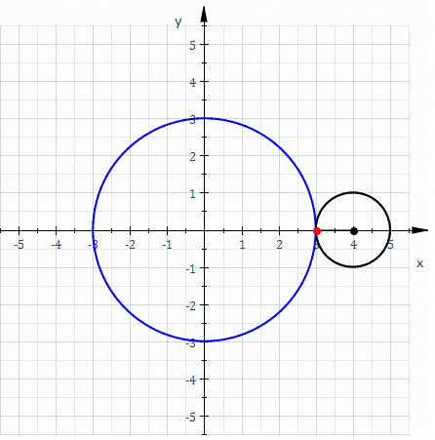
Deferents and Epicycles
To track the complex paths of planets, early Babylonian astronomers used a system of Deferents and Epicycles
Apollonius of Perga formalized this system in the 3rd century BC.
Ptolemy developed it into a complete theory of astronomy in the 2nd century BC.

Slide 8
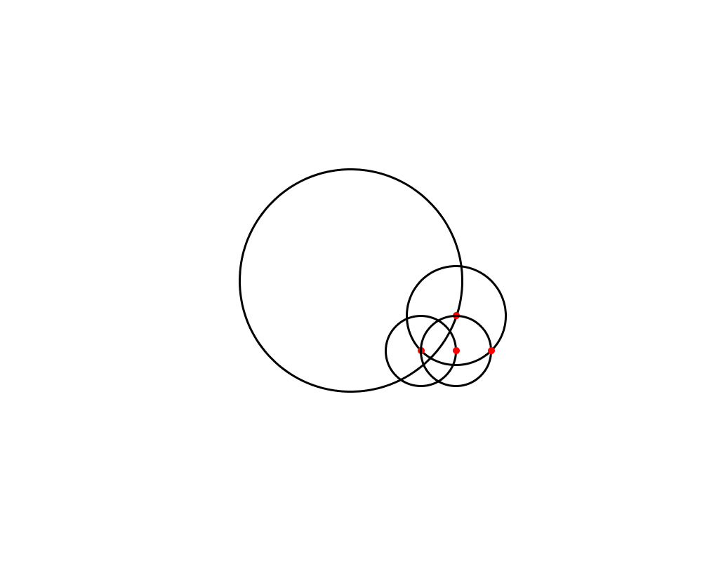
Epicycle within epicycles
However, as planetary observations became more accurate, astronomers added epicycles within epicycles to achieve better adherence of the model.
By the time Copernicus proposed the heliocentric model in the 16th century AD, the Ptolemaic system was using dozens of nested epicycles to describe planetary motion.
Important Question: What curves can be described with nested epicycles?

Slide 9
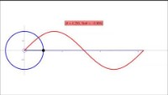
Interlude: Circles to Sine Waves
We are going to change our perspective

Slide 10
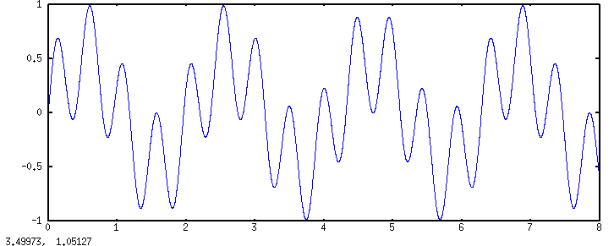
Interlude: Circles to Sine Waves
When we add an epicycle to the curve, it gives us a sine wave within a sine wave.

Slide 11
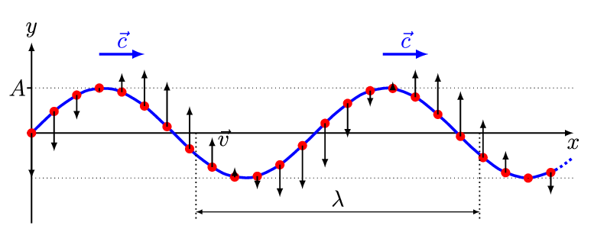
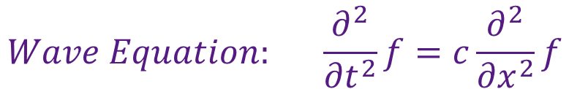
The Wave Equation
$$Wave Equation: \frac{∂^{2}}{{∂t}^{2}}f=c\frac{∂^{2}}{{∂x}^{2}}f$$

Slide 12
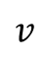

The Wave Equation
$$Wave Equation: \frac{∂^{2}}{{∂t}^{2}}f=c\frac{∂^{2}}{{∂x}^{2}}f$$
$$\ddot{v}$$
$$v$$

Slide 13
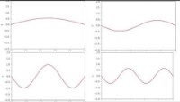
Standing Waves
There are certain solutions to the wave equation that are very simple.
In music these are called harmonics or overtones.

Slide 14
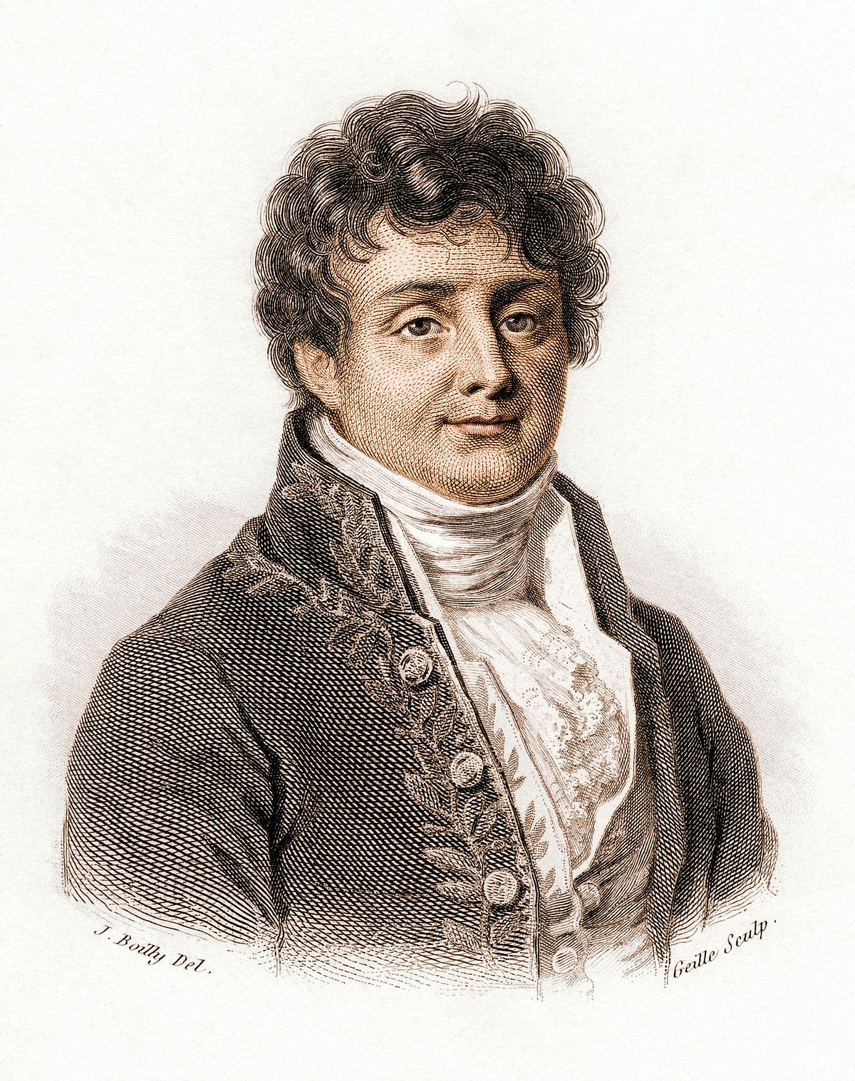
Fourier and the Heat Equation
In the 18th century, mathematicians took advantage of these simple standing waves to construct other solutions to the heat and wave equations.
In 1807, Fourier presented his Mémoire sur la propagation de la chaleur dans les corps solides to the French Academy.
Jean-Baptiste Joseph Fourier
1768-1830

Slide 15
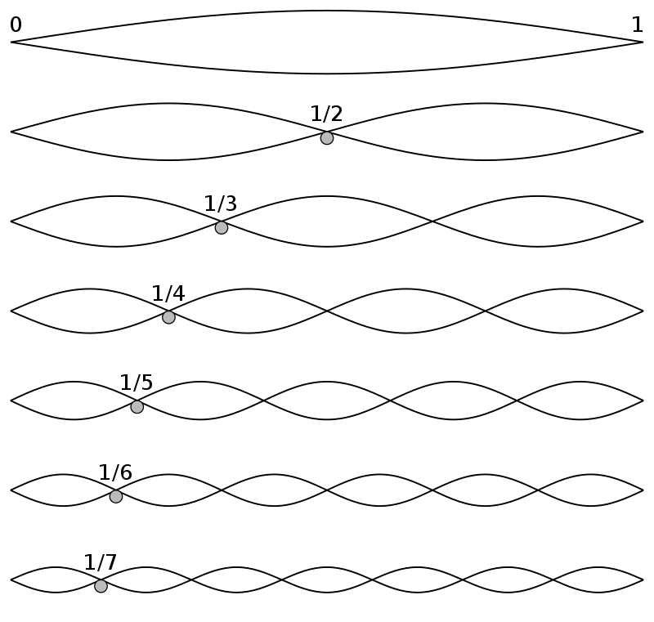
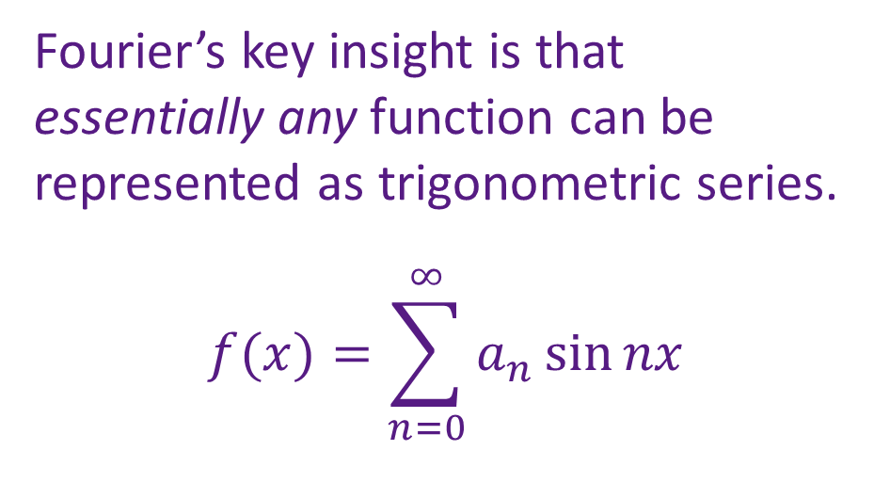
Fourier and the Heat Equation
Fourier’s key insight is that essentially any function can be represented as trigonometric series.
$$f(x)=\sum_{n=0}^{∞}{a_{n}\sin{nx}}$$

Slide 16
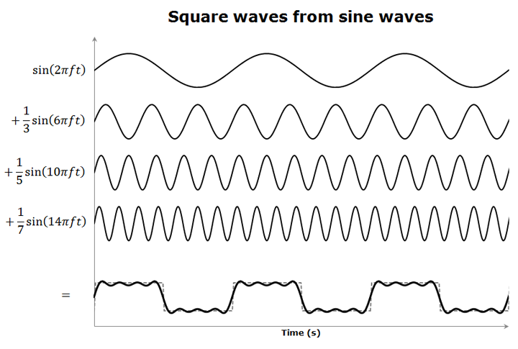
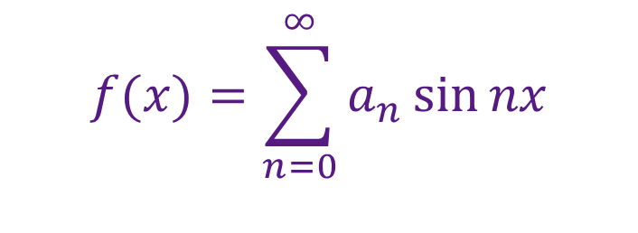
Fourier and the Heat Equation
$$f(x)=\sum_{n=0}^{∞}{a_{n}\sin{nx}}$$

Slide 17
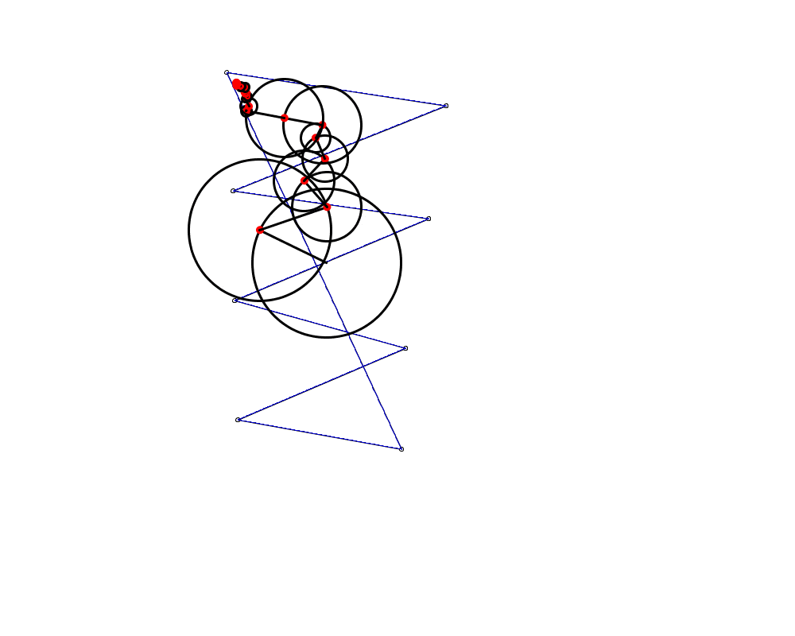
Fourier and the Heat Equation
This means that any curve can be approximated arbitrarily closely with sufficient epicycles.

Slide 18
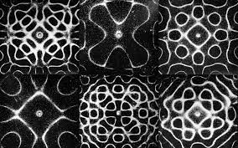
Coda: The Chladni Plate Revisited
What is special about these frequencies?
Why does the salt form these patterns?

Slide 19
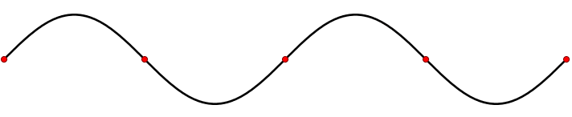
Coda: The Chladni Plate Revisited
Imagine if we pour salt onto a harmonically vibrating string (a one-dimensional drum).
Where does the salt accumulate?

Slide 20
Coda: The Chladni Plate Revisited
These patterns represent standing waves.
These are the harmonics or overtones of the drum.

Slide 21
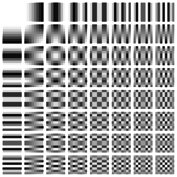
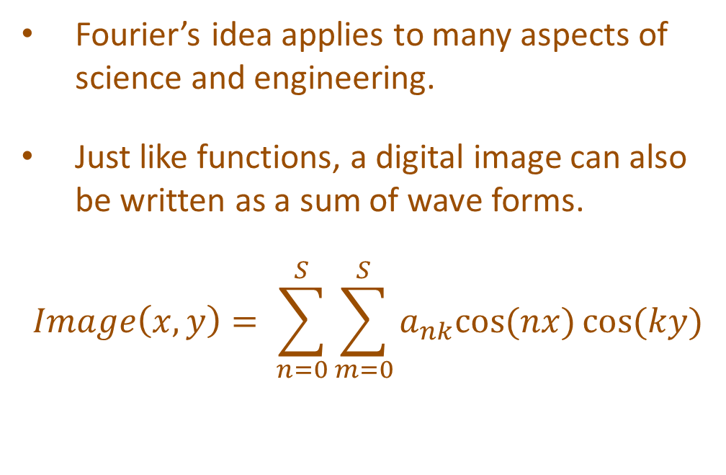
Addendum: The JPEG Standard
Fourier’s idea applies to many aspects of science and engineering.
Just like functions, a digital image can also be written as a sum of wave forms.
$$Image\left(x,y\right)= \sum_{n=0}^{S}{\sum_{m=0}^{S}{a_{nk}cos{(nx)}\cos{(ky)}}}$$

Slide 22
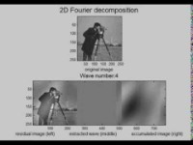
Addendum: The JPEG Standard
In this animation, we slowly remove the frequencies from the image on the left and use them to reconstruct the same image on the right.

Slide 23
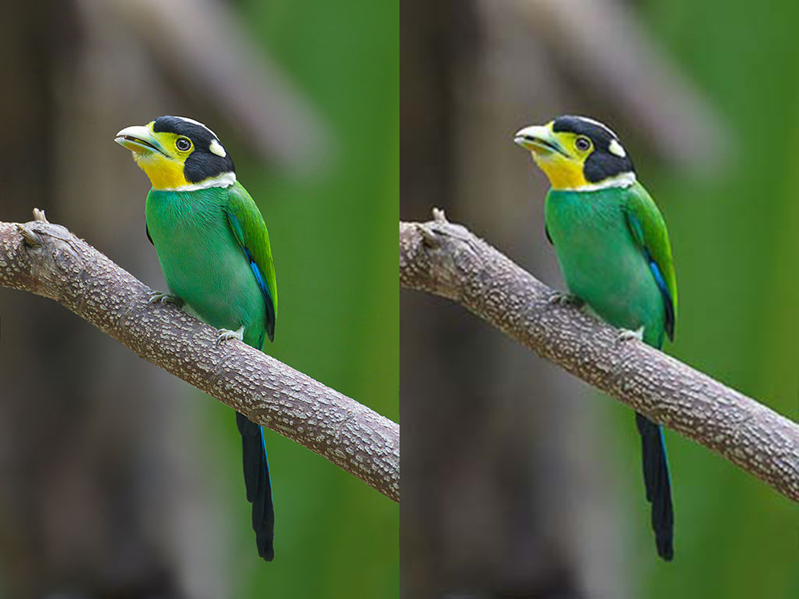
Addendum: The JPEG Standard
Here we have an image that has been compressed by discarding the high frequency overtones

